Slide 1

Image Processing
Computer Vision
James Connan

Slide 2

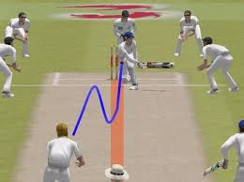
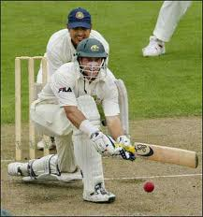
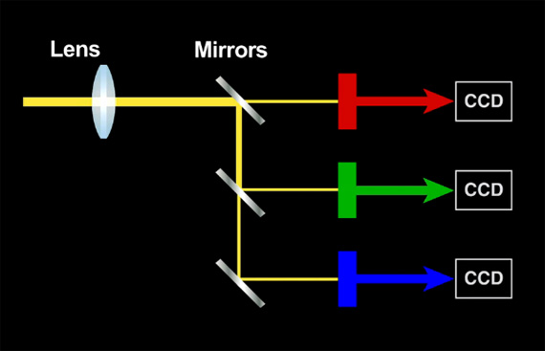
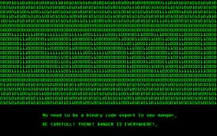

The magic

Slide 3

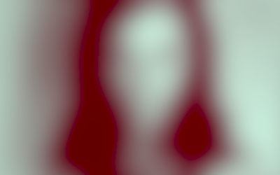
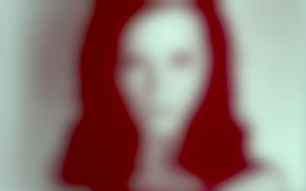
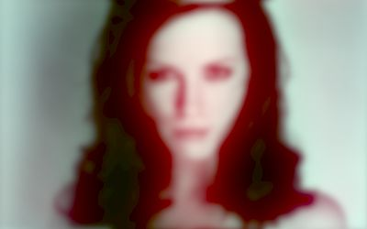
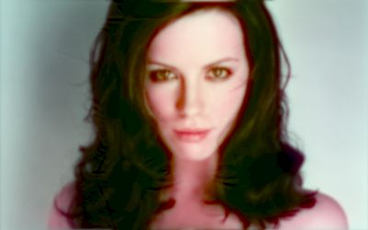
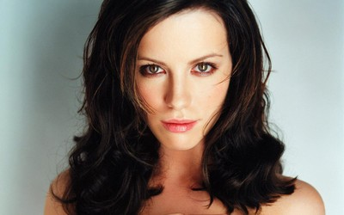

When did you learn to see?
new born
4 weeks
8 weeks
3 months
6 months
adult

Slide 4
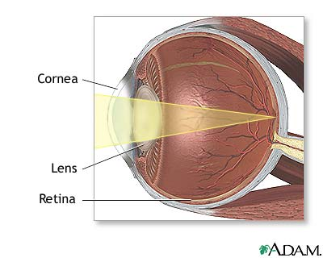
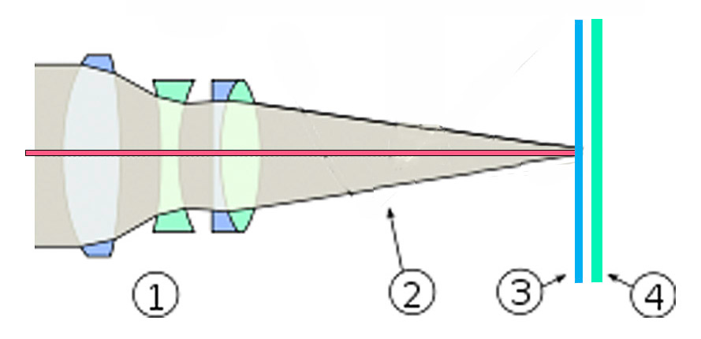
Eye vs Camera
vs

Slide 5
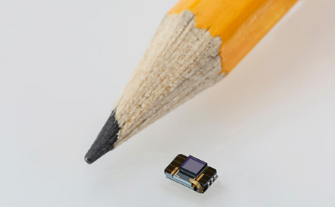
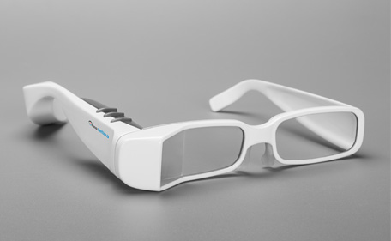
Gap is closing
Nano Retina

Slide 6
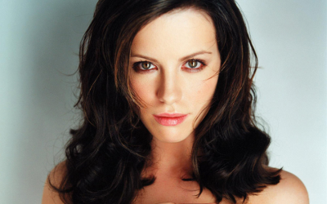
But still has a way to go

Slide 7
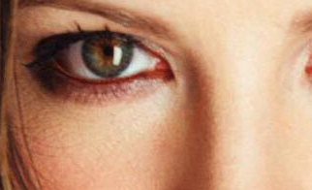



Pixels

Slide 8
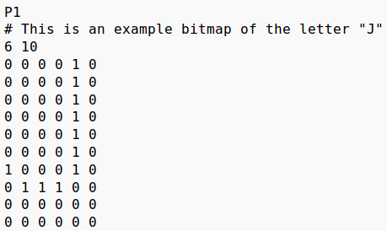

Bitmap

Slide 9
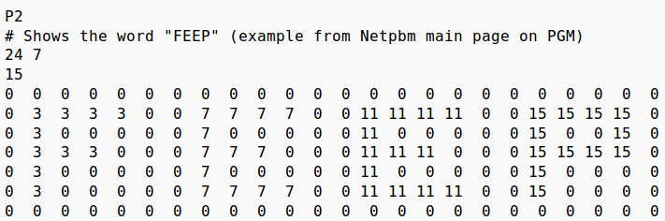

Grayscale

Slide 10
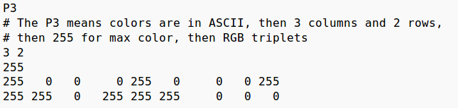

Colour (RGB) image

Slide 11
Videos are images

Slide 12
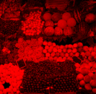
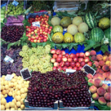
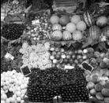
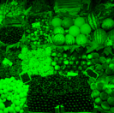
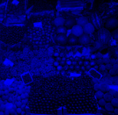
RGB → Grayscale
30% Red + 59% Green + 11% Blue = Gray

Slide 13
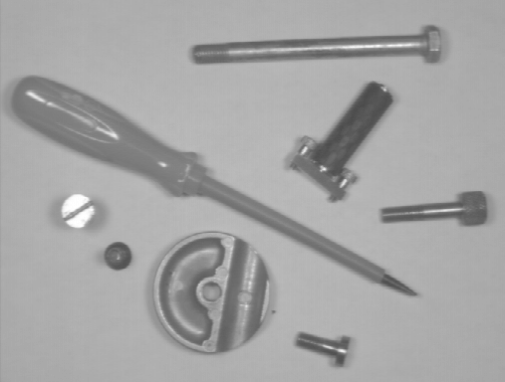
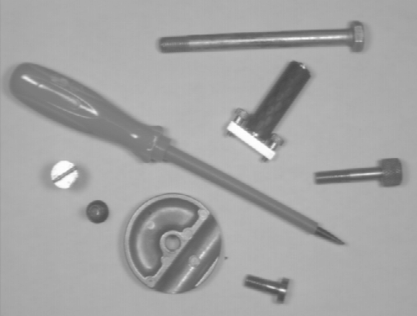
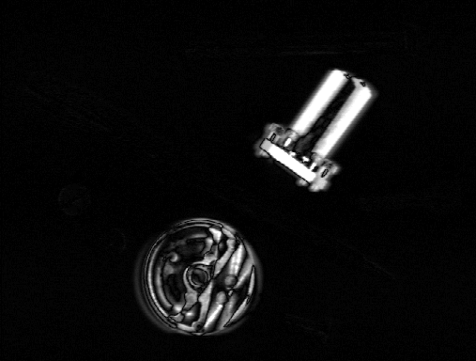
Image differencing

Slide 14
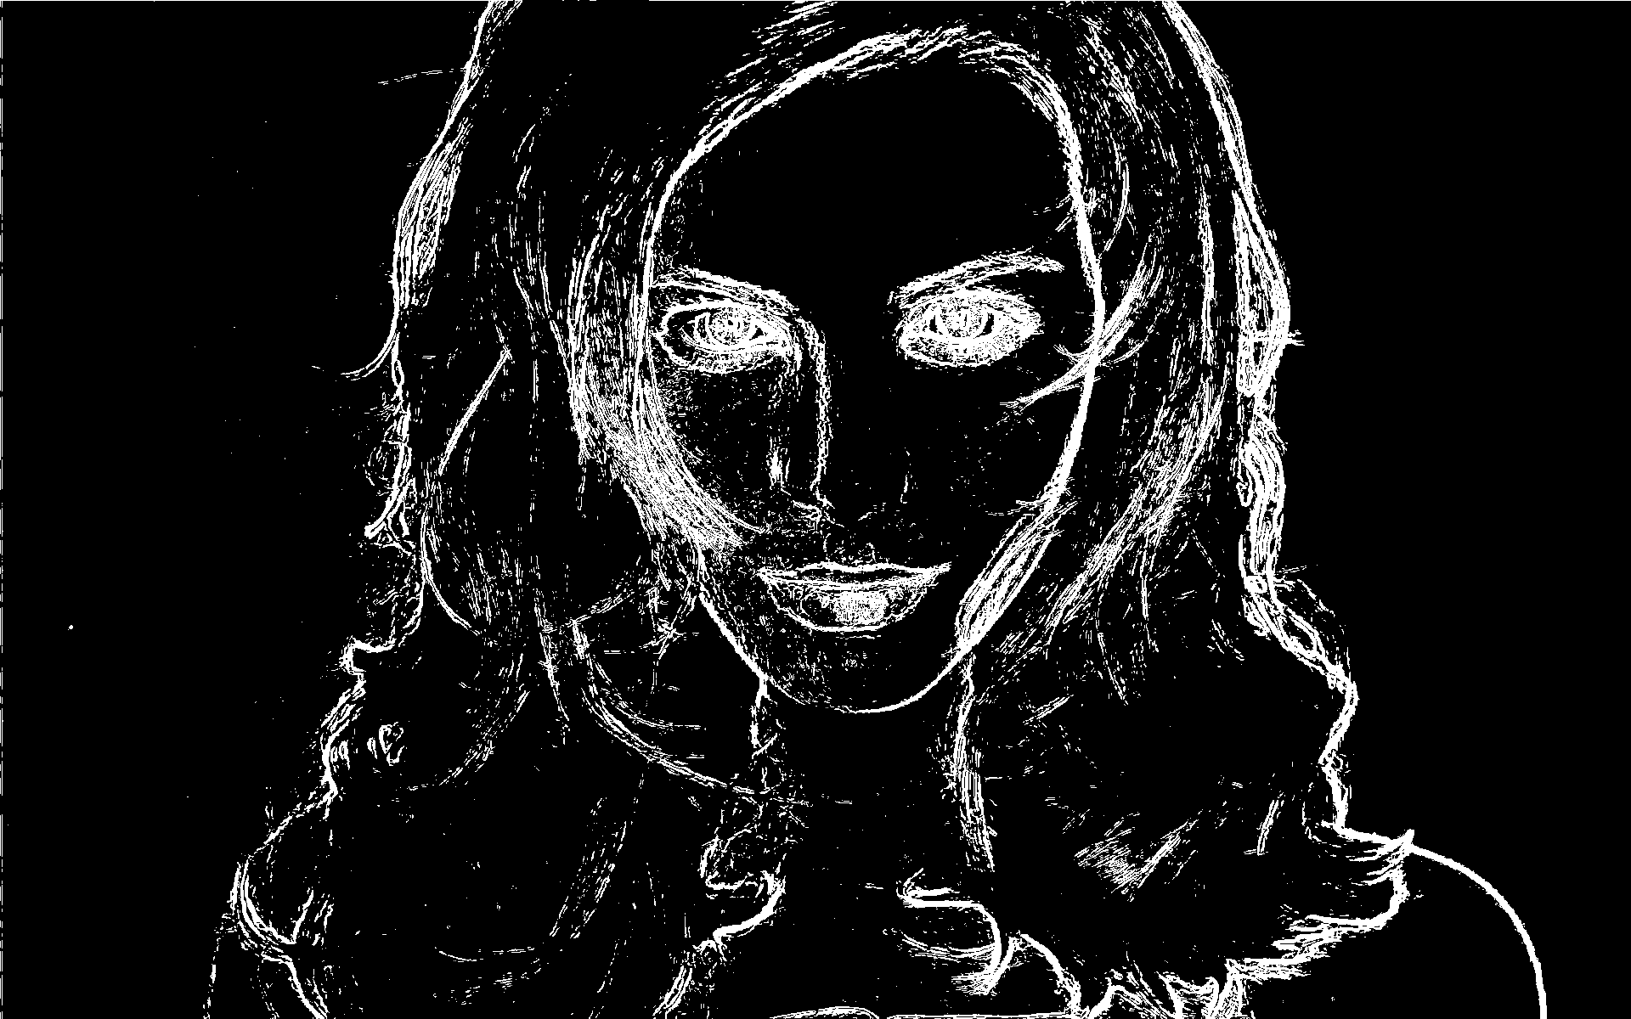
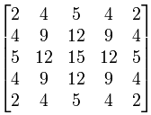
Edge detection

Slide 15
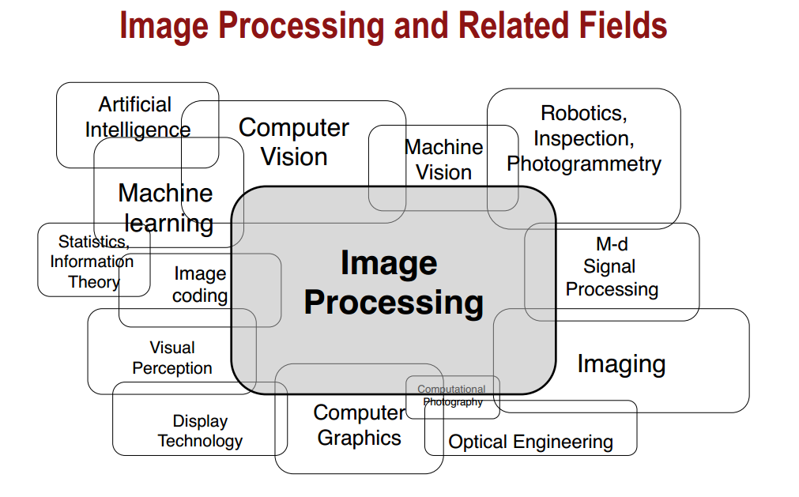

Slide 16

Applications
Hand tracking
Hand shape estimation
Eye tracking
Security
Fish identification
PhoneReader
Bi manual hand tracking
Bi manual hand tracking
Facial expressions
Lie detection

Slide 17
Demos and Questions

Slide 18

Proposed topics
Image formats
  PBM, PGM, PPM
Colour spaces
  RGB, HSV/HSI
Filters
  Blur, Sharpen, Edge detection
Algorithms
  Subtraction, Scaling, Chamfer Distance Transfer, Face detection, Thresholding, Adaboost, Segmentation, Morphological operations
OpenCV

